Slide 1
03- Build your first dag

Slide 2
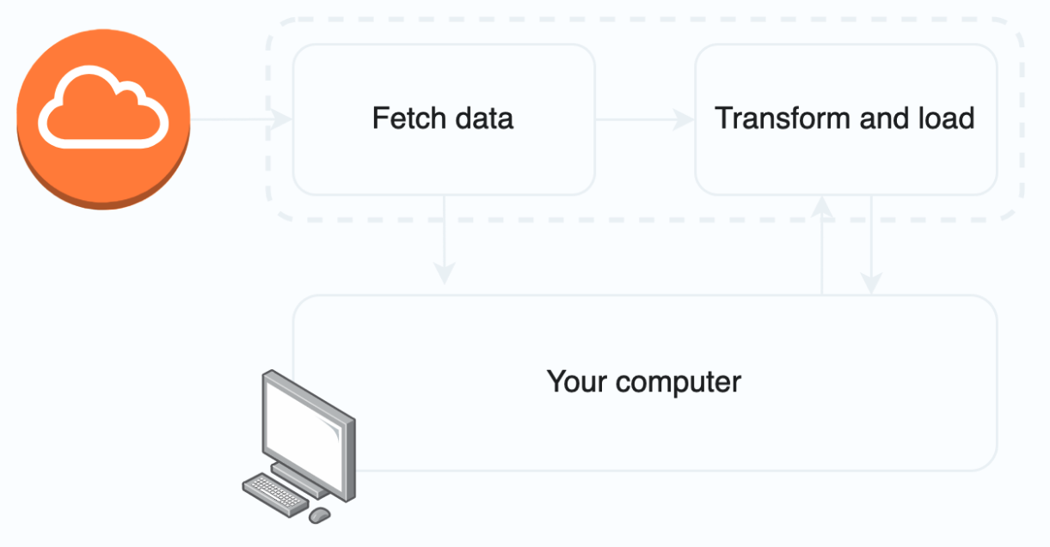
Goal
This example is for crypto kiddos! We are going to build a DAG that will fetch Bitcoin (BTC) price and save it into a CSV file.
To summarize:

Slide 3
Custom docker-compose.yaml
Create a new working folder, let's call it crypto-dag.
We are going to start from scratch a new Airflow docker-compose instance. We need to custom our configuration file so as to add a new data folder as volume. This way, we allow Airflow to write and read inside this folder. We are going to use data to store some JSON files and our final CSV.
Inside crypto-dag, we can curl the docker-compose.yaml file from the Airflow website.
Inside crypto-dag, we can curl the docker-compose.yaml file from the Airflow website.
$ curl -LfO 'https://airflow.apache.org/docs/apache-airflow/2.3.2/docker-compose.yaml'

Slide 4
Custom docker-compose.yaml
Create a new working folder, let's call it crypto-dag.
We are going to start from scratch a new Airflow docker-compose instance. We need to custom our configuration file so as to add a new data folder as volume. This way, we allow Airflow to write and read inside this folder. We are going to use data to store some JSON files and our final CSV.
Inside crypto-dag, we can curl the docker-compose.yaml file from the Airflow website.
Inside crypto-dag, we can curl the docker-compose.yaml file from the Airflow website.
$ curl -LfO 'https://airflow.apache.org/docs/apache-airflow/2.3.2/docker-compose.yaml'

Slide 5
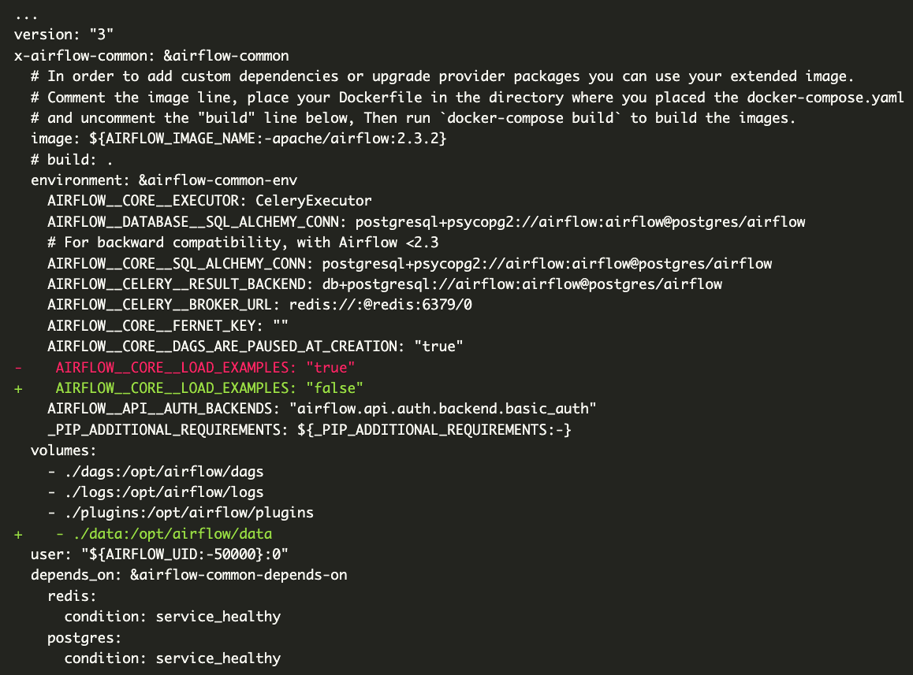
Custom docker-compose.yaml

Slide 6
Custom docker-compose.yaml
Simply add the line - ./data:/opt/airflow/data in the list of volumes. You can also set AIRFLOW__CORE__LOAD_EXAMPLES to false to avoid loading the examples, making the DAG's list clearer.
Let's create the data folder and a dags folder inside crypto-dag:
$ mkdir data dags
Once it is done, we can docker-compose up airflow-init then docker-compose up our new Airflow docker-compose instance.

Slide 7
Declare the DAG
Ok! We are ready to go!
Create a new Python file into the dags folder. Name it crypto_dag.py.
To define a DAG, you need to import the DAG class from the airflow module and create a scope with with:
from airflow import DAG
with DAG("crypto_dag", start_date=datetime(2022, 1, 1), schedule_interval="@hourly", catchup=False) as dag:
pass

Slide 8
Declare the DAG
What do we do here? We use DAG to tell Airflow that what we follow under the with scope is the definition of a DAG.
DAG takes some parameters:
crypto_dag is the name of our DAG.
start_date is the date when the DAG will start.
schedule_interval="@hourly" tells Airflow to run the DAG every hour, you can choose other presets or define your own cron schedule.
catchup=False tells Airflow to not catchup if runs fail.
There are many more parameters. We will discover some of them later.
First you need to check if you have Docker installed and running. Check if docker-compose is installed too.

Slide 9
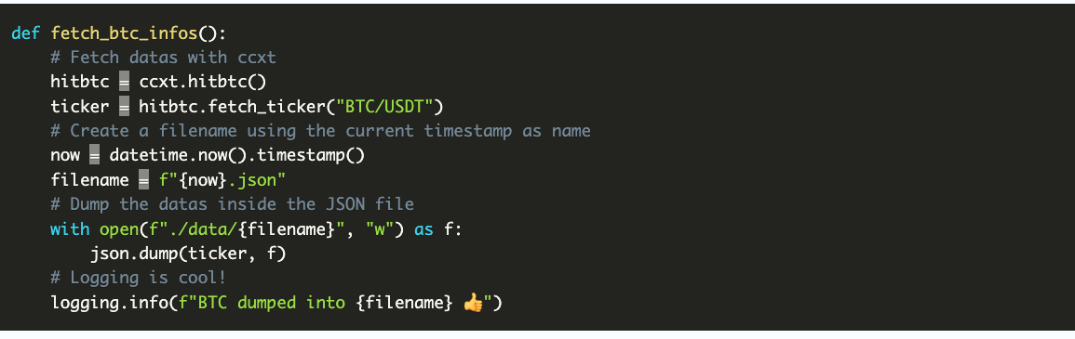
First task
Our first task is going to fetch the datas, and save it into a JSON file inside data folder.
In order to fetch the cryptos datas, we are going to use a Python library called ccxt.
We are not going to detail too much how ccxt works, thus take it for granted. ccxt will return us a bunch of datas about BTC, with the price in USD.
Let's build a new function fetch_btc_infos that will fetch the datas from ccxt and store it into a file in data folder.

Slide 10
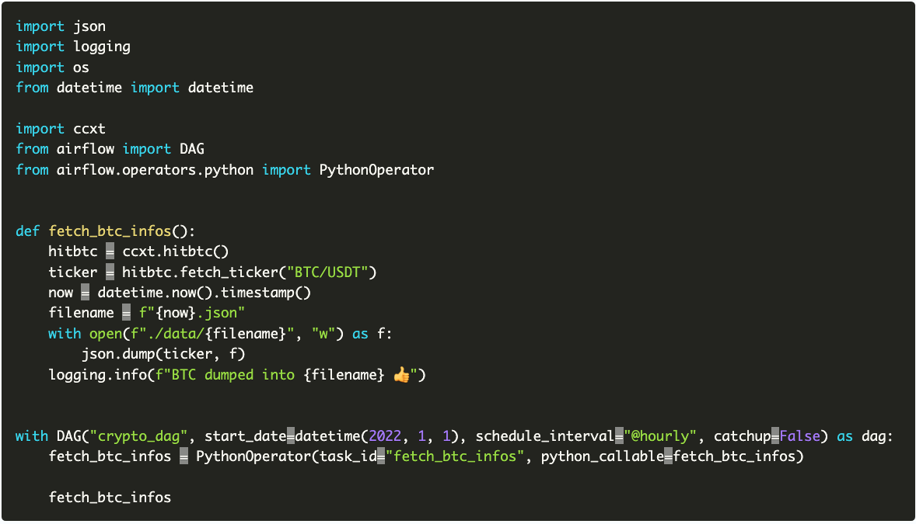
First task
We need to add fetch_btc_infos to our crypto_dag DAG. As it is a Python code, we need to use the PythonOperator to wrap it.
At the end, your crypto_dag.py should look like this:

Slide 11
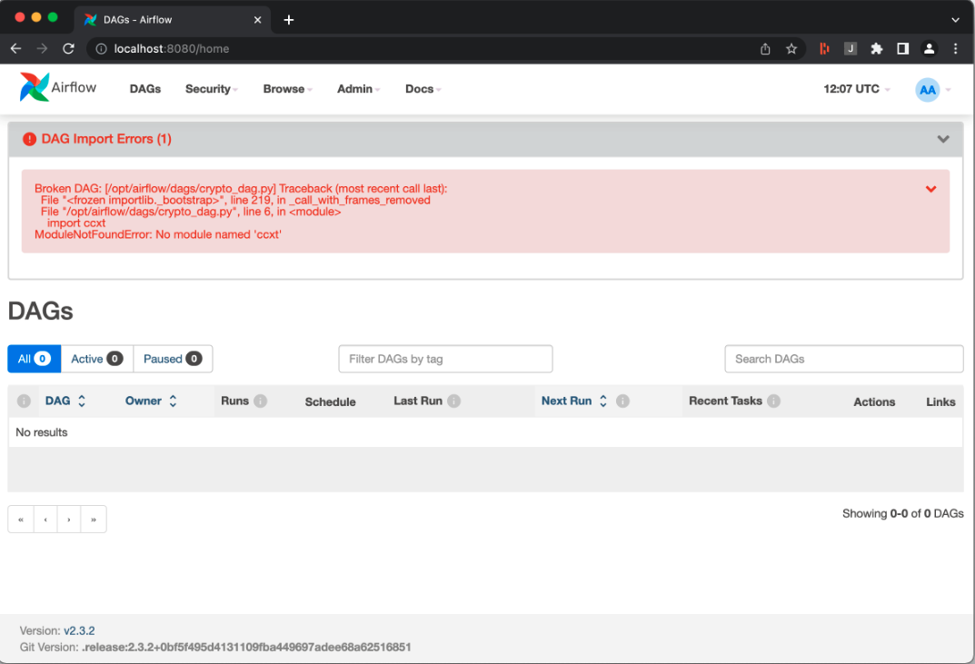
First task
We add the PythonOperator with the task_id equal to "fetch_btc_infos" (you can call it whatever you want) and the python_callable to fetch_btc_infos which is the name of our function. It will be called by Airflow when the task is executed.
Ok! Let's check the Airflow webserver interface at http://localhost:8080/. What do you see? Airflow is telling us we are missing requirements. We are going to remedy this.

Slide 12
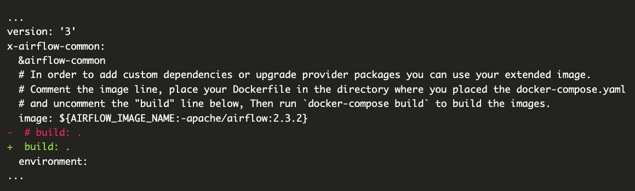
Customize environment
In order to use our image instead of the default one, we need to update the docker-compose.yaml:
We just need to uncomment the build line.
Then, stop and restart the docker-compose
$ docker-compose down # or use ctrl-C to stop it
$ docker-compose up --build

Slide 13
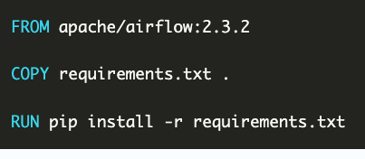
Customize environment
In order to add the ccxt library to our Python execution environment, we need to customize the Airflow Docker.
Create a new Dockerfile with the following content:
And create a requirements.txt file with the following content:
ccxt==1.85.*

Slide 14
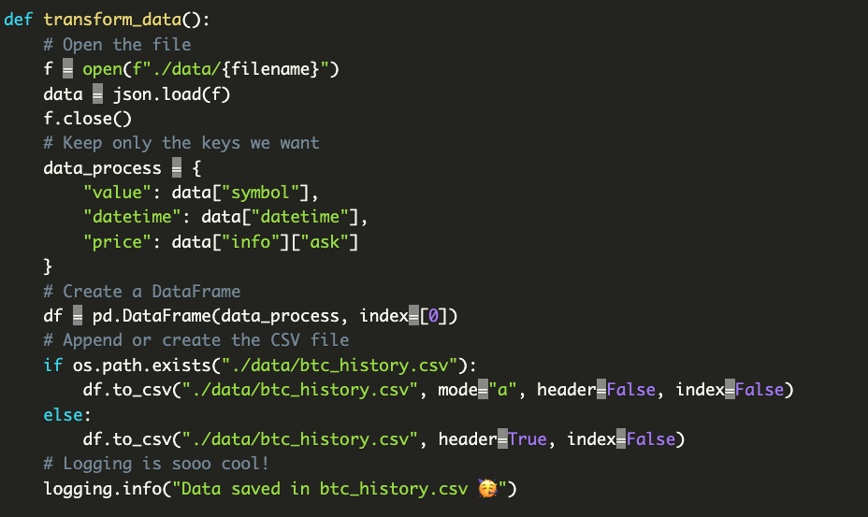
Add a second task
Second part of our pipeline is to get the data from the JSON file and append only certain keys to a CSV file. This CSV file is like our database.
The second task function looks like:

Slide 15
Add a second task
If you copy/paste this function and add it to the DAG like we did for the first one, you certainly had an error. In fact we omitted to add the filename variable. How can we do to pass the filename from the first task to the second one?
You got it: XCom! With XCom we are able to use xcom_push to store data and xcom_pull to retrieve it. Those functions are accessible inside the task_instance. Well, where can we catch this task_instance?
Each time we wrap a task in a PythonOperator, a bunch of parameters are given to our callable by default. We can access the task_instance simply adding ti (or task_instance) parameter as it was a function parameter

Slide 16
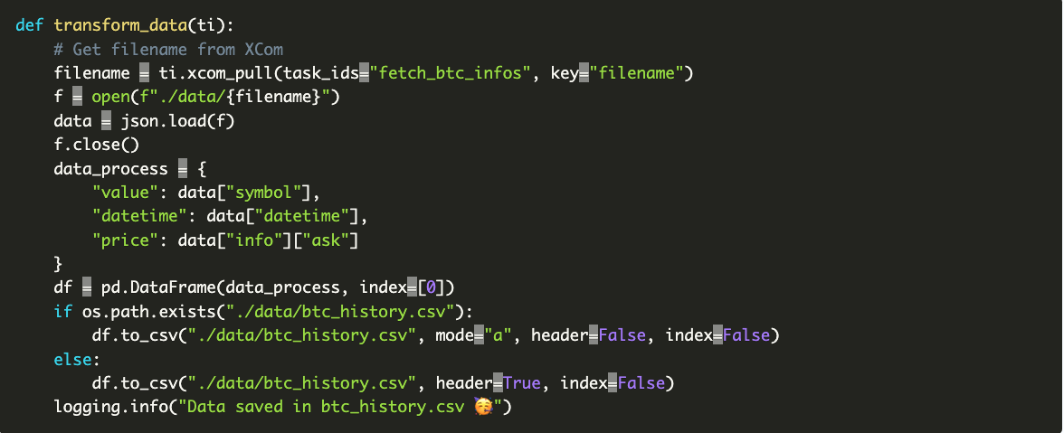
So how does our second task look like with XCom?

Slide 17
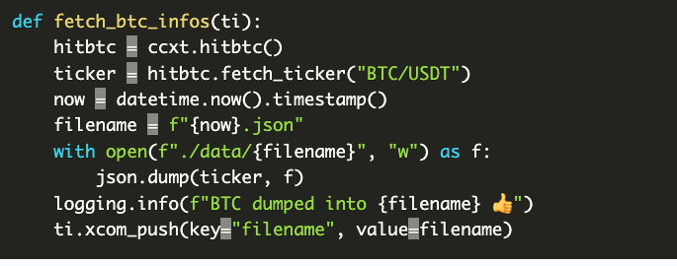
Buuut, we haven't used the ti.xcom_push function yet to store filename. Update the first task:

Slide 18
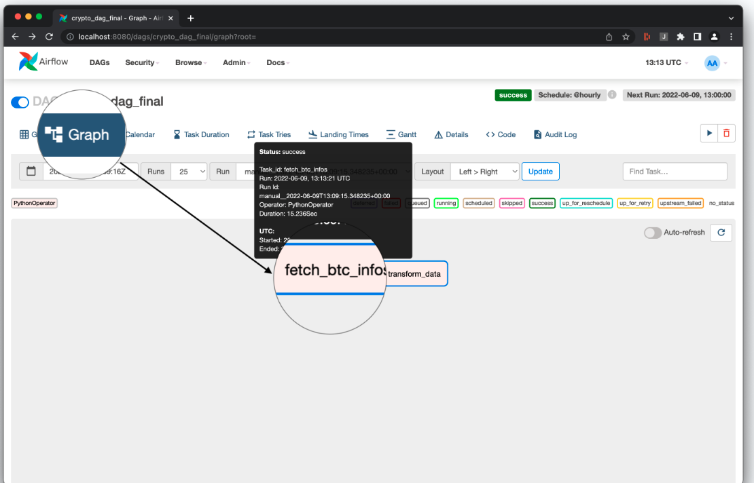
Run!
Let's run the DAG!
If everything went well, you should see a btc_history.csv file in the data folder. If you run the DAG multiple times, you will see a new line after each run.
It works!
You can check the XCom through the interface:

Slide 19
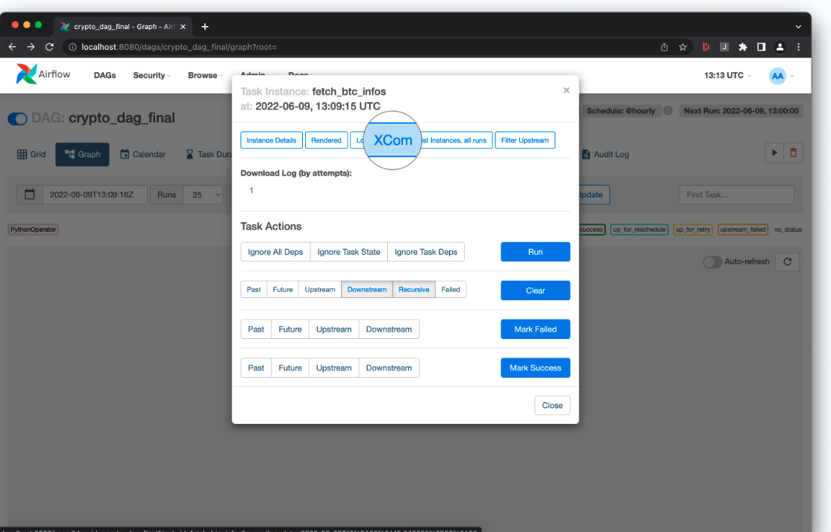
Go to graph and click on the first task (the one pushing the XCom).

Slide 20
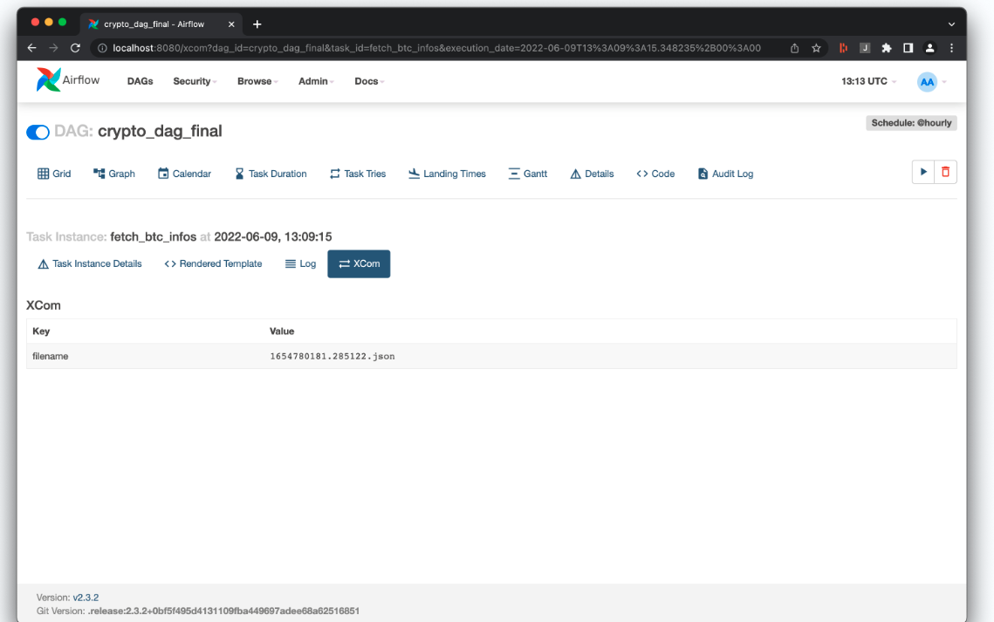
Click on XCom.

